Slide 1
Kaylin Moody
Adebayo Eisape
Notes:
kaylin

Slide 2
Agenda
Background
Market information
Components of Insulin Pump
Problem Statement
Methods
Logo
Video Demo
Expenses
Business Model
Acknowledgements
Notes:
kaylin

Slide 3
Background
Diabetes refers to a group of diseases that results in too much sugar being in the blood
Effects of diabetes include blindness, nerve damage and coronary heart disease
Typical treatments for diabetes includes:
Taking several insulin injection every day or using an insulin pump
Monitoring blood sugar level several times a day
Notes:
bayo

Slide 4
Market Information
29 million people in the US (178M in the world) have diabetes
Unfortunately, projected to increase 50% by 2050
200k people in the US (300k in the world) use an insulin pump
Focus on US market (greater than 60% of market)
Sample size of about 384 with an error margin of 5%
Cannulas are changed every 3 to 5 days
Total market worth ~$1,460,000,000 ($1.46B)
From an economic perspective, the total annual cost of diabetes in 2012 was estimated to be $245 billion in the United States. This included $116 billion in direct medical costs (healthcare costs) for people with diabetes and another $69 billion in other costs due to disability, premature death, or work loss.
Notes:
bayo

Slide 5
Components of Insulin Pump
(Control center)
(Cannula)
http://ipag.co.uk/wp-content/uploads/2010/07/pumps_Medtronic_insulin-pump-components.jpg
Notes:
kaylin

Slide 6
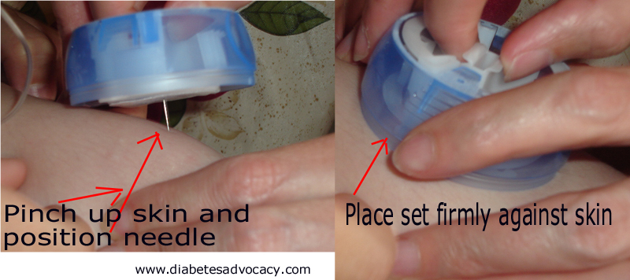
Problem Statement
Notes:
kaylin

Slide 7
CannuAlert Use Flow Chart
Insert Cannula
Is Cannula Bent?
No
End
Reset system
Yes
Alert User
Remove cannula
Notes:
bayo

Slide 8
Methods
Electrospinning
Coat needle in a piezoelectric skin, then coated in titanium
Polyvinylidene Fluoride
Pulse Detection
Amplifier between needle and microprocessor
Microprocessor waits for pulse, latches notification LED
User must reset system to clear alert
Notes:
Kaylin, bayo

Slide 9
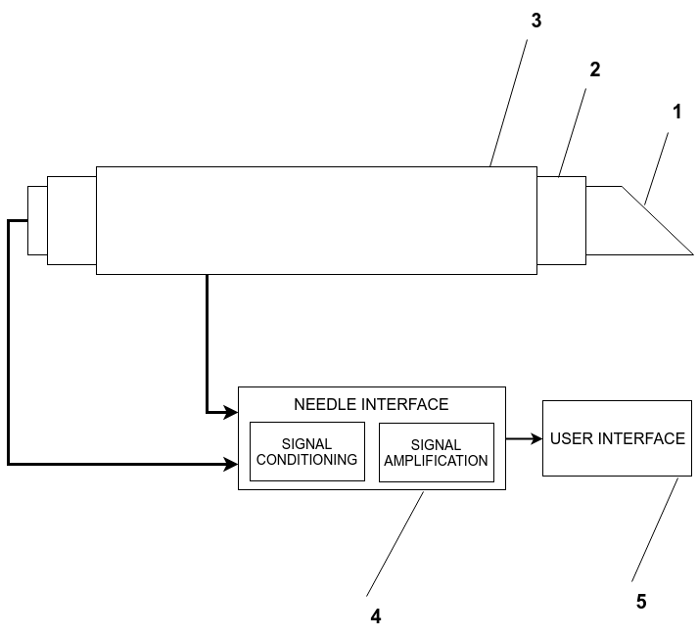
Design Layout
Notes:
Bayo
Add amplifier and signal conditioning to needle interface

Slide 10
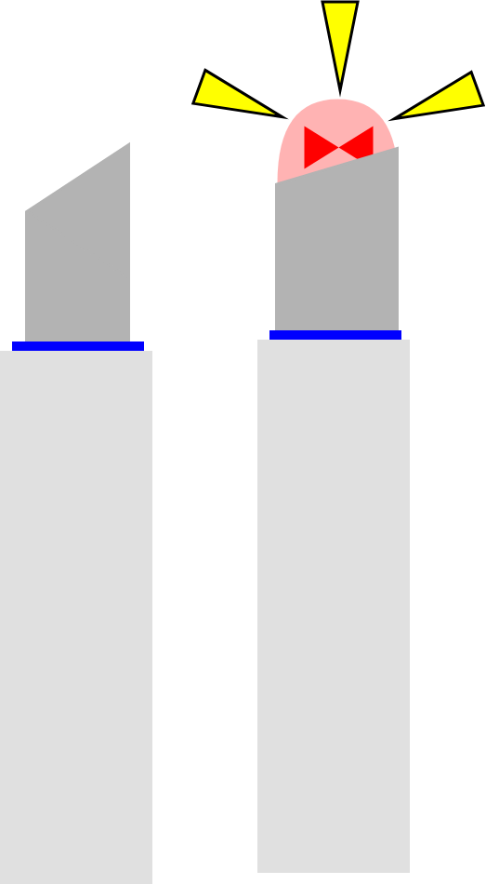
Logo Ideas
Notes:
Ffa-ask class

Slide 11
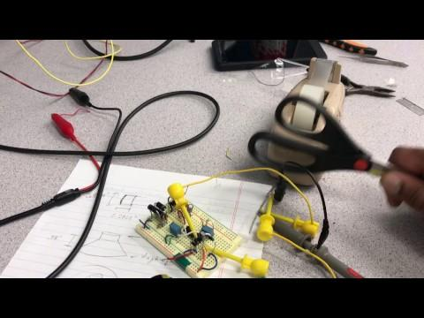

Slide 12
Business Model
Razor-razorblade model
Sell insertion handles at a discount, sell refills at slightly above typical price
Electrospinning is relatively cheap, so needle can be priced similarly to competitors
Partner with clinics and insurance companies for advertising
Manufacturing costs
A business model similar to Tesla Motors’
Initial needles will be more expensive and manufactured with current technologies
Extra revenue will pay for labor and development of automatic system
Subsequent cannulas will be cheaper as a result
Notes:
bayo
http://www.investopedia.com/terms/r/razor-razorblademodel.asp

Slide 13
Expenses
- Syringe Driver Pump - $1000 - High Voltage (20kV) DC Amplifier - $2500 - Motors, Actuators, and Drivers - $200 - Humidifier System - $80 - Mandrel (rotating collector) - $200 - Enclosures - $200 - Syringes, cables, wires, etc. - $120 - 3D Printed fixtures - $200 - Poly(vinylidene fluoride) (PVDF)- $90 6m roll Total (approx.): $4500
- Engineers, testing (Human trials), etc
- Grand total - $2M
Sensors and Materials,Vol 28, No. 7, p757-762
Notes:
Avg researcher - 77K per year
Clinical Trials:https://www.centerwatch.com/clinical-trials/overview.aspx
https://www.centerpointclinicalservices.com/blog-posts/driving-drive-drug-innovation-and-market-access-part-1-clinical-trial-cost-breakdown/

Slide 14
Acknowledgments
Dr.James West
Valerie Rennoll
Our Professors: Dr.Israel Gannot and Sathappan Ramesh
Camden Partners
Notes:
Competitive Advantage
Financial break down

